Slide 1
PROJECT – Automatic Vehicle Number Plate Detection and Recognition (ANPR)
PREPARED BY - YATRIK SHAH

Slide 2
OUTLINE
-> ABSTRACt
-> PROBLEM STATEMENT
-> METHODOLOGY
-> Difficulties Without ANPR Model
-> Glimpse of api
-> REAL LIFE APPLICATIONS

Slide 3
ABSTRACT
Computer vision is a field of study focused on the problem of helping computers to see.
the goal of computer vision problems is to use the observed image data to infer something about the world.
In huge systems of vehicle control like traffic management on highways or traffic management in big events and at highway tolls gathering information of the vehicles which were involved, by their number plates manually is very difficult so, AI can solve this problem using advanced computer vision algorithms.

Slide 4
Problem Statement
As manually number plate data collection and maintenance is very challenging and can be very time consuming task, it may not be possible to perform it on millions of vehicles.
So as a solution, we can automate it using deep learning and computer vision.

Slide 5
Methodology
-> Data Gathering
-> Data cleaning and preprocessing
-> Defining extracting bounding box in images using Deep learning
-> MODEL bUILDING
-> Model training
-> Cross validation and hyperparameter tuning
-> uSING ocr for img to text
-> Frontend with HTML – css
-> Api integration with flask
-> deployment

Slide 6
Data Preprocessing & Augmentation
Resizing -> (640 * 640 )
Augmentation:
Rotation (-15 to +15) angle
Brightness ( -25% to +25%)

Slide 7
Model Building & Training
1. Custom CNN model:
Custom CNN model with custom layers i.e. Convolution Layers, Dropout Layers, BatchNormalization Layers, Maxpooling Layers, Dense Layers
2. YOLOV5

Slide 8


Database
SQLite
Time & Date
Download Database
Reset Session

Slide 9

Without ANPR Model
-> More Human Power
-> Slow Process
-> Time Consuming
-> More Expenses on Human Resources

Slide 10




REAL-LIFE APPLICATIONS
at toll plazas.
Tracking Stolen Vehicles
Road safety and security systems.
Traffic management

Slide 11
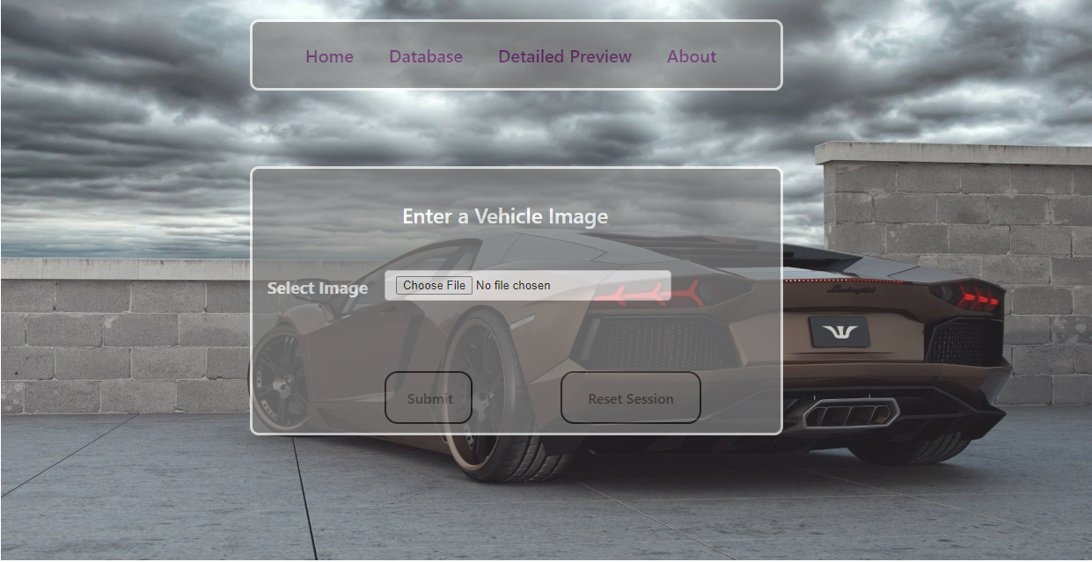
Glimpse OF API

Slide 12
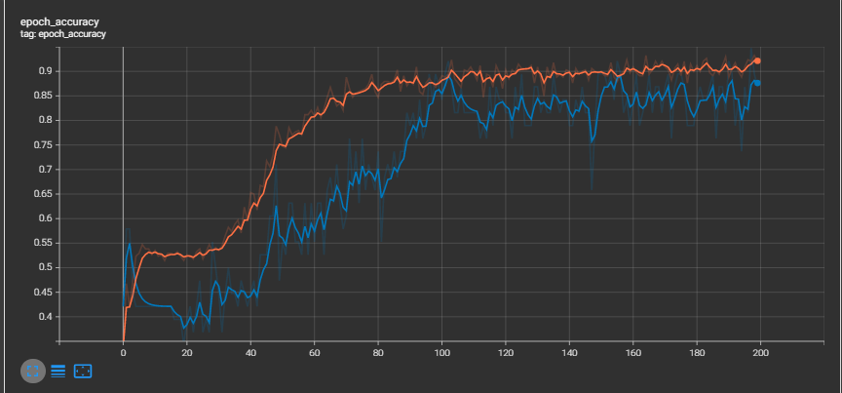
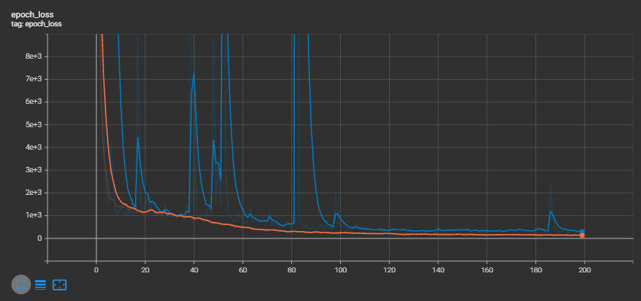
Accuracy
Epochs
Loss
Epochs

Slide 13
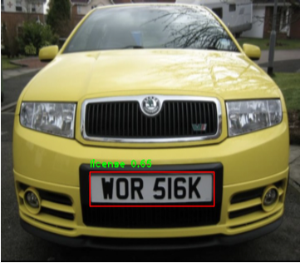
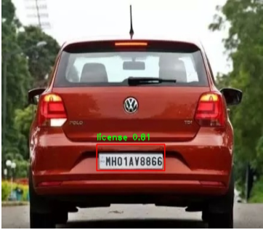
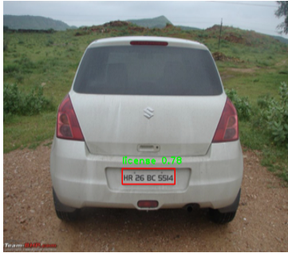
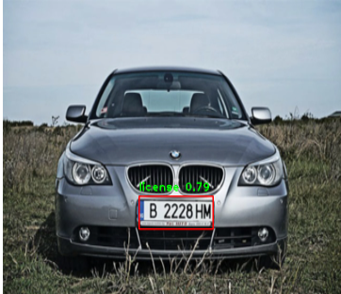
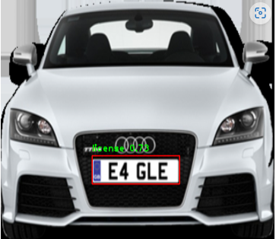
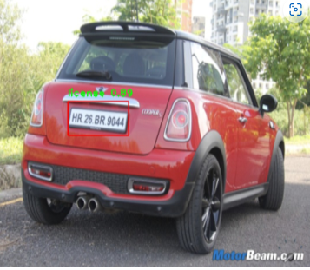
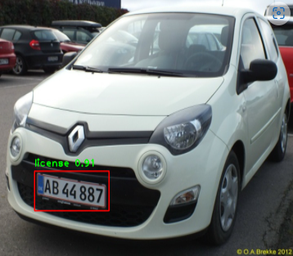
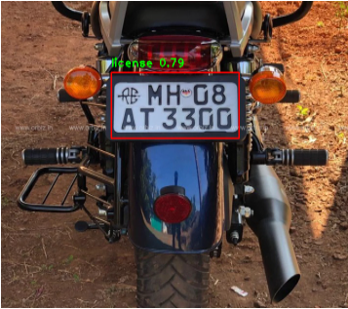
Performance of Detection Model on Test Images

Slide 14
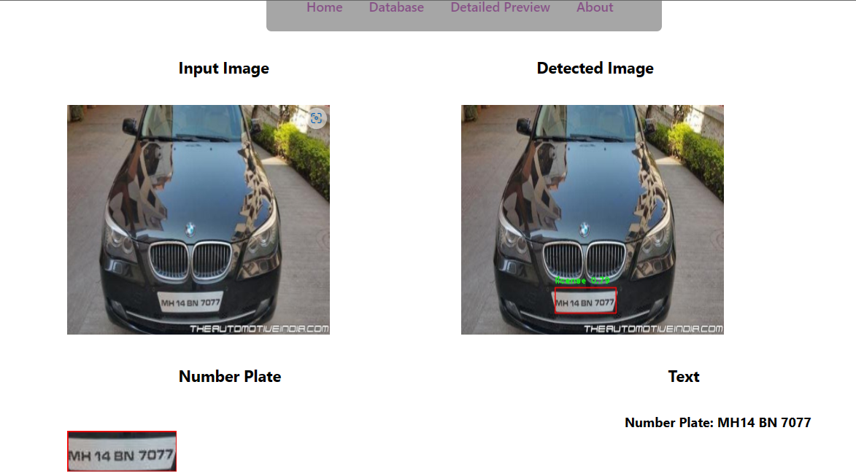

Slide 15
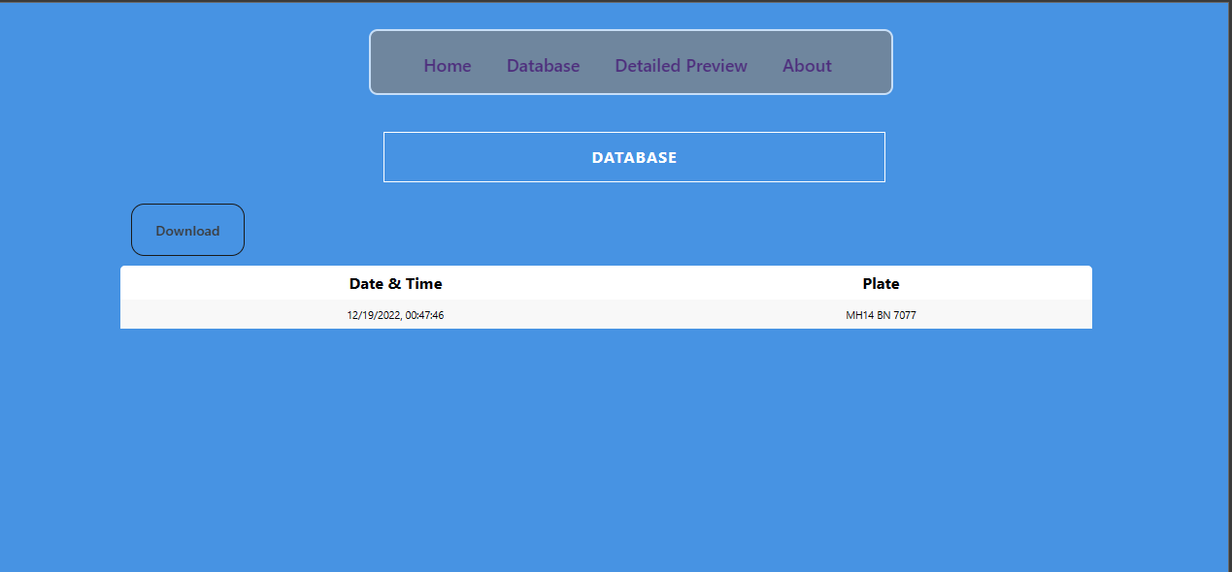

Slide 16
Any
Questions?

Slide 17
THANK
YOU

